Slide 1

Procedure, Function and Triggers

Slide 2

Procedure Exercises

Slide 3
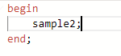
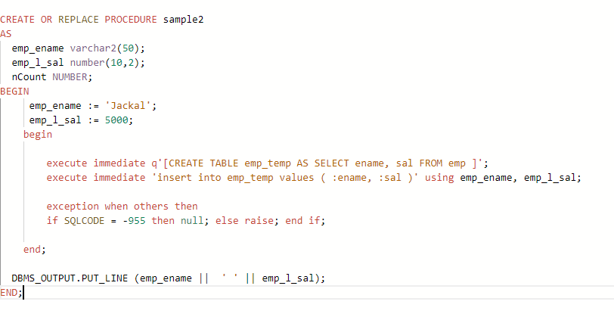
Exercise 1
Create a procedure that will create a table out from an existing table.
Insert a new record in the new table
Show the results

Slide 4
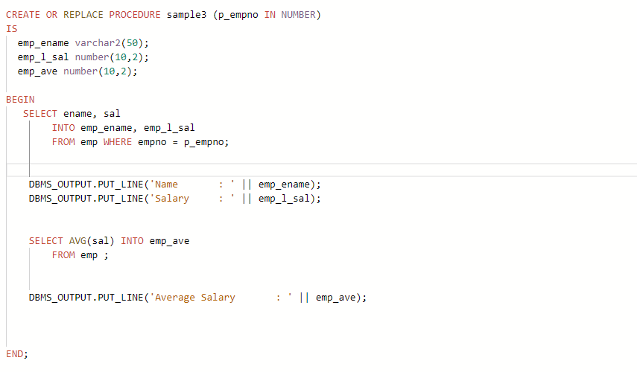
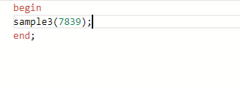
Exercise 2
Create a procedure that will accept an employee number and show the his salary and the overall average salary of all employees

Slide 5
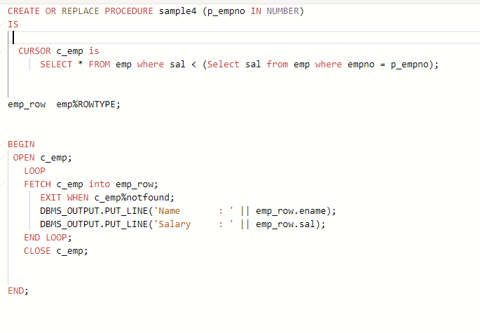
Exercise 3
Revise your previous procedure but this time show all employees who have a salary lower than the employee in question.

Slide 6

Functions Exercises

Slide 7
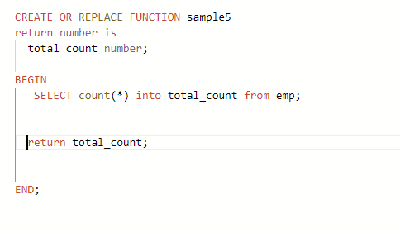
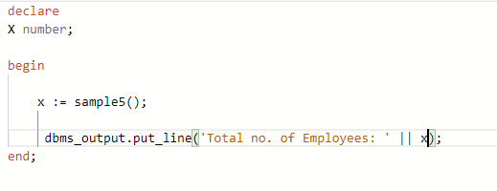
Exercise 1
Create a function that will return the total number of employees

Slide 8
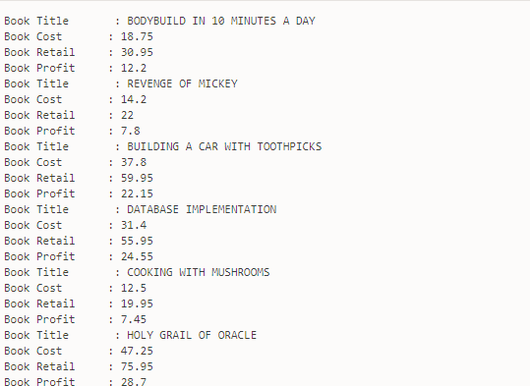
Exercise 2
Create a function that will accept two numeric parameters c and r representing cost and retail.
It will return the profit which is r – c.
Create a procedure that will read the books table.
Inside this procedure you will call this function and supply it with the cost and retail of every book.
The final output will be a list of book titles, cost, retail and the profit.

Slide 9
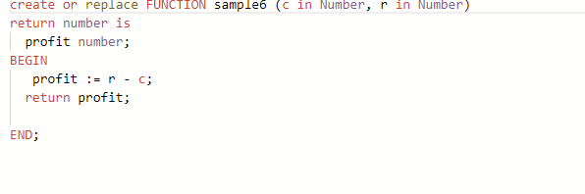
Clue: The function is the following:

Slide 10
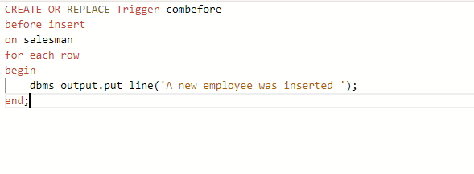
Exercise 1:Triggers
Show a message that says “A new employee inserted “ every time a new employee is added to the salesman table

Slide 11
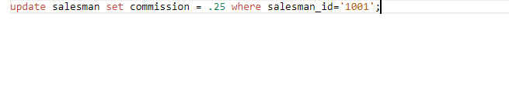
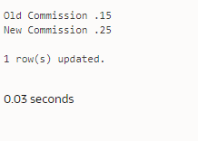
Exercise 2
Revise your first trigger.
Show the old commission and the new commission every time an update is done.

